Slide 1

Prompt Engineering for Developers
Miguel Bastidas
Edgar Galindo
Hector Triana

Slide 2
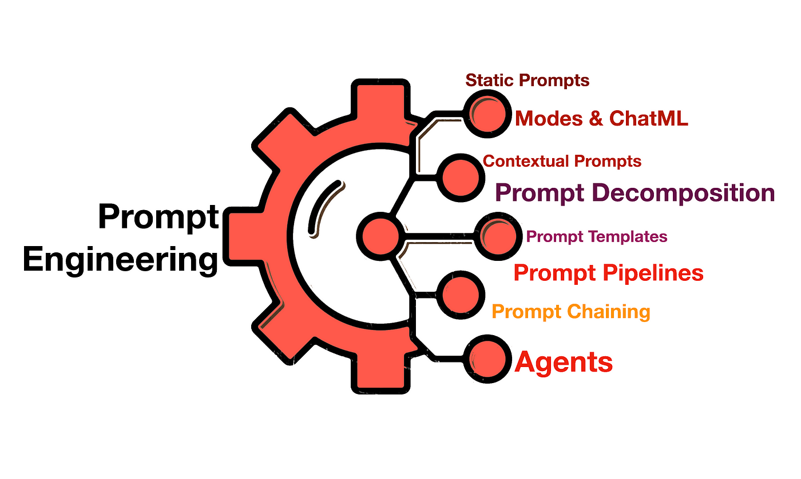

What is Prompt Engineering?
Prompt engineering is the practice of designing effective input instructions (prompts) to guide AI models, like LLMs (Large Language Models), to produce desired outputs. It’s a critical skill for developers working with AI because the quality of the output often depends on the clarity and precision of the prompt.
This advanced AI is known as generative AI because it's being developed in real time with input from users and developers alike. Ultimately, AI tools are still learning from your shared interactions, and finding out how to create effective prompts can help the AI model provide the desired response.

Slide 3
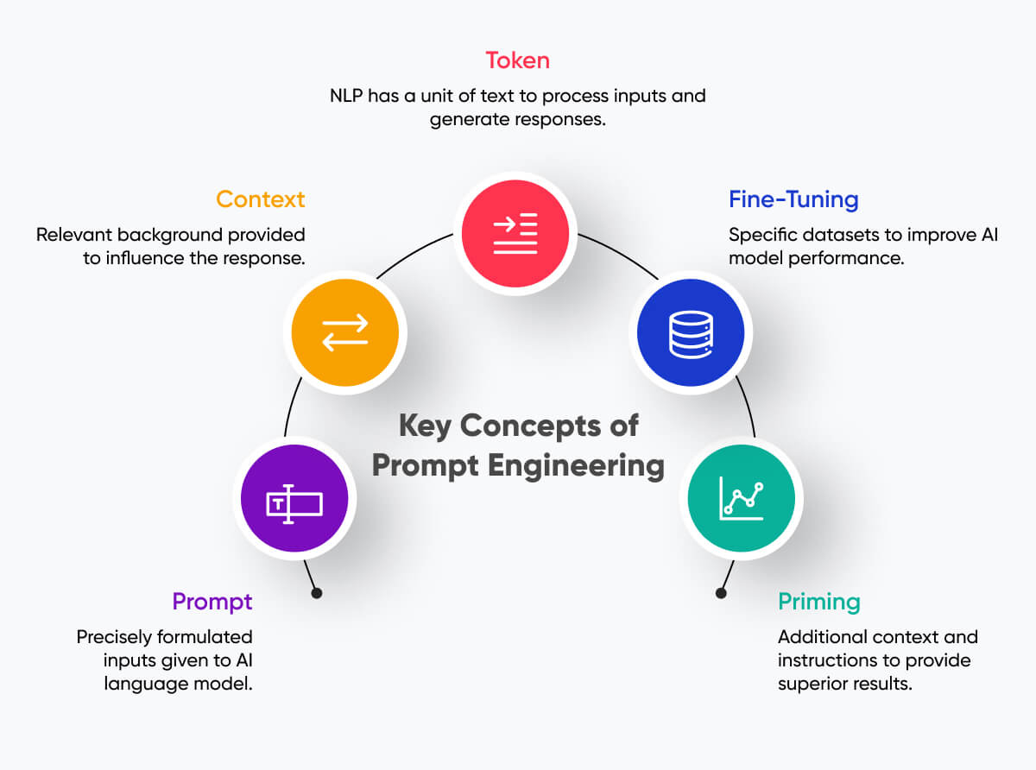
Common Rules
Be precise in saying what to do (write, summarize, extract information).
Avoid saying what not to do and say what to do instead,
Be specific: instead of saying “in a few sentences”, say “in 2–3 sentences”.
Add tags or delimiters to make the prompt.
Ask for a structured output (JSON, HTML) if needed.
Ask the model to verify whether the conditions are satisfied (e.g. “if you do not know the answer, say “No information”).
Ask a model to first explain and then provide the answer (otherwise a model may try to justify an incorrect answer).
Be Clear and Specific: Clearly define the task, expected format, or language.
Use Context and Examples: Providing context, such as a sample input/output, can guide the model more effectively. For example, ask for code in a specific programming language or format.
Guide with Constraints: Use phrases like “in Python,” “write as a comment,” or “use functional programming style” to set boundaries.
Break Down Complex Tasks: For larger tasks, break down the prompt into simpler subtasks. This can involve multi-step prompts where each response builds on the last.
Iterate and Refine: Experiment by rephrasing, adding constraints, or testing variations of prompts to optimize output.
Leverage Temperature and Max Tokens: Adjusting these parameters can make the output more creative (higher temperature) or concise (lower max tokens).

Slide 4
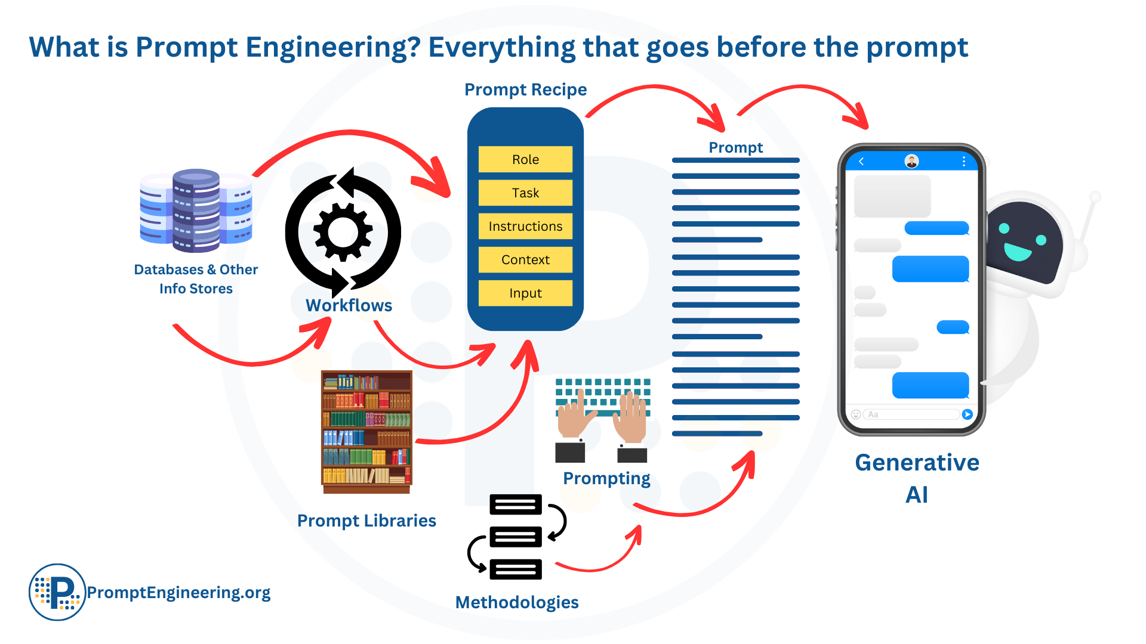
Use Cases
Prompt engineering is a powerful tool to help AI chatbots generate contextually relevant and coherent responses in real-time conversations.
In healthcare, prompt engineers instruct AI systems to summarize medical data and develop treatment recommendations.
Prompt engineering plays a role in software development by using AI models to generate code snippets or provide solutions to programming challenges.
Because generative AI systems are trained in various programming languages, prompt engineers can streamline the generation of code snippets and simplify complex tasks. By crafting specific prompts, developers can automate coding, debug errors, design API integrations to reduce manual labor and create API-based workflows to manage data pipelines and optimize resource allocation.
Prompt engineering is used to develop and test security mechanisms. Researchers and practitioners leverage generative AI to simulate cyberattacks and design better defense strategies. Additionally, crafting prompts for AI models can aid in discovering vulnerabilities in software.

Slide 5
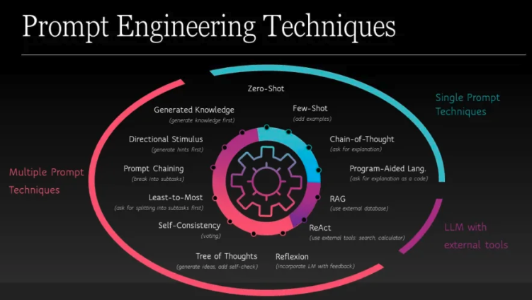

Slide 6
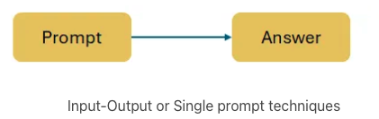
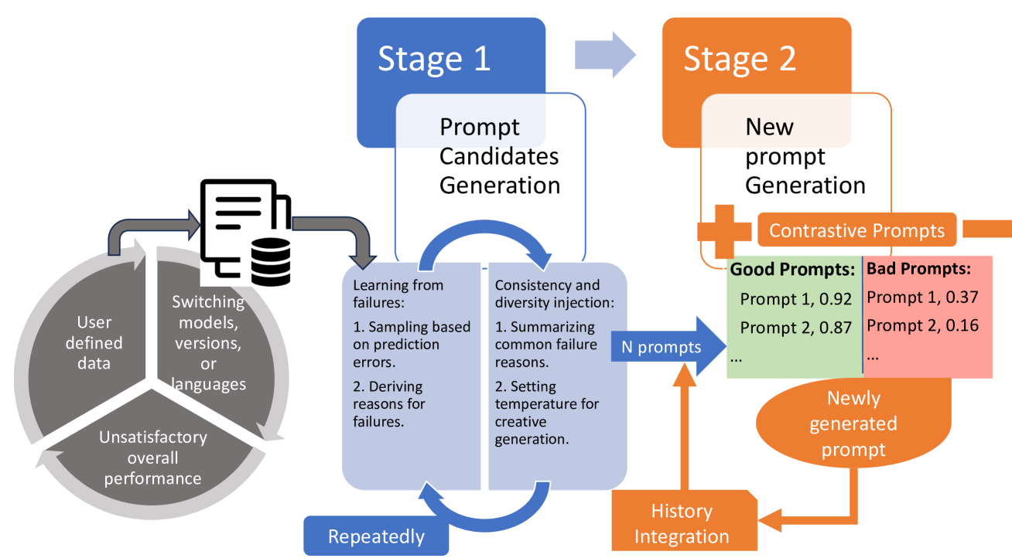

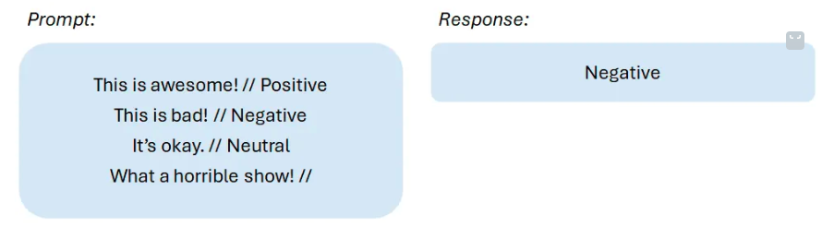
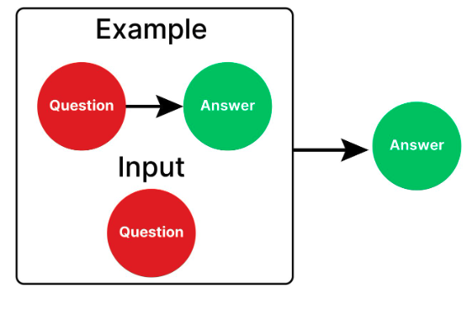
Zero-Shot Prompting
Meta Prompting
One-Shot Prompting

Slide 7
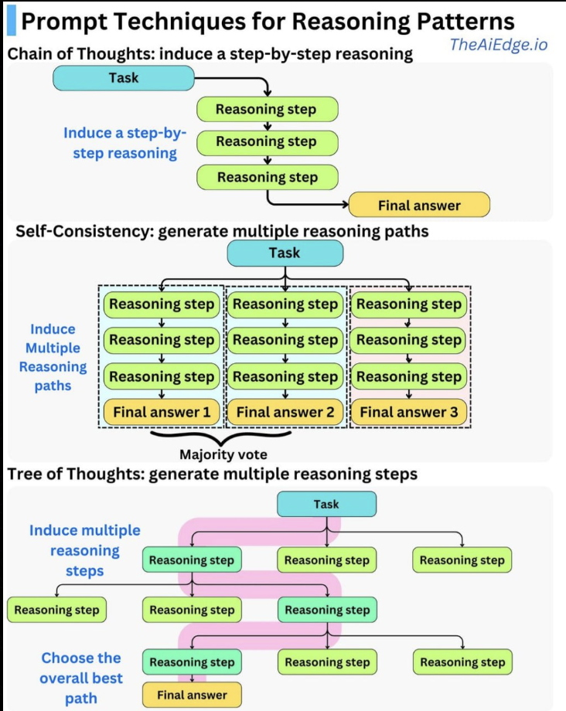
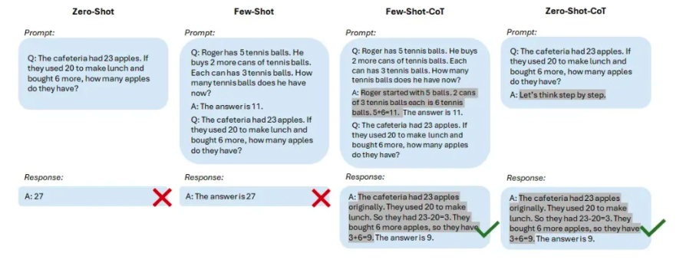
Chain of Thought Prompting (CoT)
Chain-of-Thought prompting enables complex reasoning capabilities through intermediate reasoning steps. This technique aims to make the model iterate and reason each step.

Slide 8
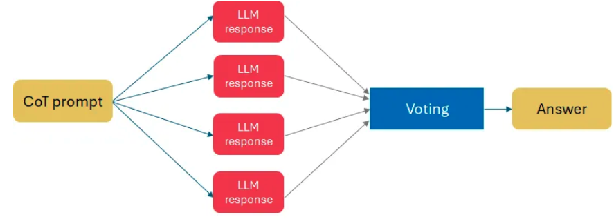
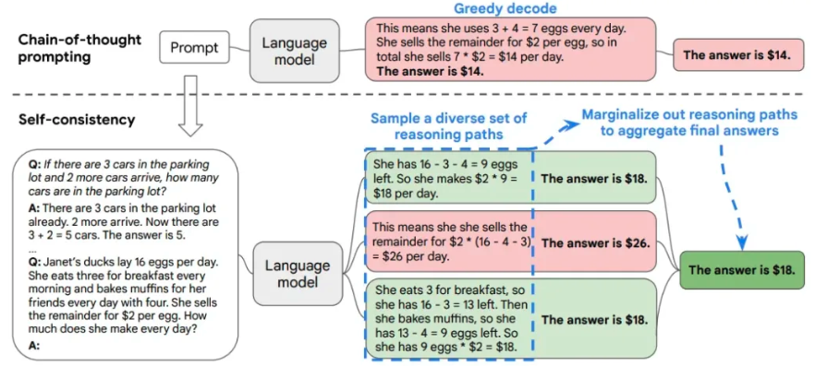
Multiple Prompt Techniques
The next group of prompts is based on different strategies of combining prompts of one or a few of models:
Voting. The idea is to apply voting to get the correct answer. Techniques: Self-Consistency.
Divide and conquer. This group of prompts is based on dividing a complicated task into a few prompts. Techniques: Directional Stimulus, Generate Knowledge, Prompt Chaining, Chain-of-Table and Least-to-Most prompting.
Self-evaluation. The approach suggests including into a framework a step of checking whether the output meets instructions. Techniques: Reflexion, Tree-of-Thoughts.
Self Consistency (SC)
Based on the intuition that “a complex reasoning problem typically admits multiple different ways of thinking leading to its unique correct answer”

Slide 9
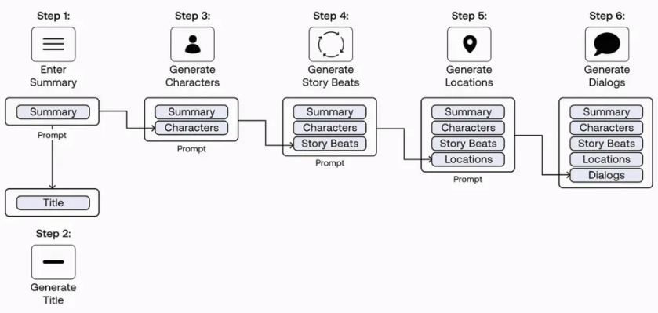
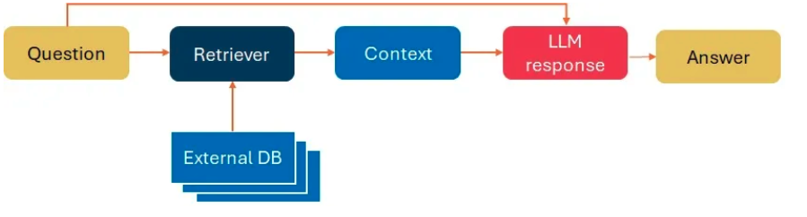
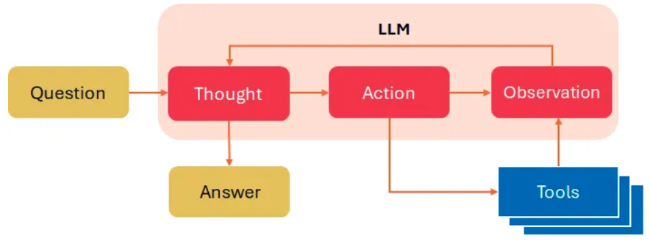
Prompt Chaining
Technique in which you should split your task into subproblems and prompt the model with them one by one.
LLM frameworks with external tools
Retrieval-Augmented Generation (RAG)
RAG combines an information retrieval component with a text generator model:
Retrieval. At the retrieval step the system searches for relevant documents that might answer the question typically using the vector search,
Generation. Next the relevant documents are passed as a context to an LLM together with the initial question.
In most cases RAG-sequence approach is used meaning that we retrieve k documents, and use them to generate all the output tokens that answer a user query.
ReAct where LLMs are used to generate both reasoning traces and task-specific actions in an interleaved manner: reasoning traces help the model induce, track, and update action plans as well as handle exceptions, while actions allow it to interface with and gather additional information from external sources such as knowledge bases or environments.

Slide 10
Hands-On Practice with Prompt Engineering
Easy Exercise: Function Creation Prompt
Task: Write a prompt to generate a Python function that calculates the Fibonacci sequence up to a given number n.
Guidance: specify that the function should return a list of Fibonacci numbers.
Medium Exercise: Medium Exercise: Code Documentation Prompt
Task: Write a prompt that asks the AI to document an existing function in Python, explaining each line in comments.
Guidance: use a sample function, like a sorting algorithm, and ask for line-by-line documentation.
Hard Exercise: Multi-Step Prompt for API Integration
Task: Create a prompt to generate a Python script that fetches weather data from an API and processes it.
Guidance:
The first prompt should request code to fetch data from a weather API (like OpenWeatherMap).
The second prompt should ask for code to parse and display relevant data like temperature, humidity, etc.
Feel free to use the AI model of preference and compare the results, the main goal is how to make prompts to make possible your goals.

Slide 11
Reference Links
https://www.ibm.com/topics/prompt-engineering
https://promptengineering.org/what-is-prompt-engineering/
https://mailchimp.com/resources/prompt-engineering/
https://www.promptingguide.ai/techniques
https://www.analyticsvidhya.com/blog/2024/07/one-shot-prompting/#h-what-is-one-shot-prompting
https://www.prompthub.us/blog/a-complete-guide-to-meta-prompting
https://medium.com/accredian/meta-prompting-unlocking-ais-power-to-self-improve-f1ee40974a4a
https://www.godeltech.com/blog/prompt-engineering-classification-of-techniques-and-prompt-tuning/

Slide 12


